Slide 1





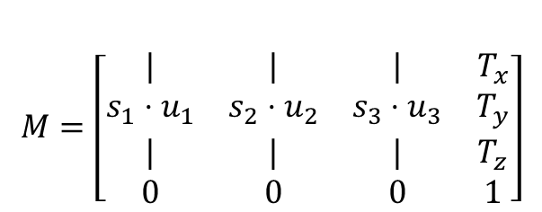





$$Figure$$
$$Y$$
$$Axes$$
$$u_{2}$$
$$M=\left[\begin{matrix}| & | & | & T_{x} \\ {s_{1}⋅u}_{1} & s_{2}⋅u_{2} & s_{3}⋅u_{3} & T_{y} \\ | & | & | & T_{z} \\ 0 & 0 & 0 & 1\end{matrix}\right]$$
$$T_{x}$$
$$Transform$$
$$u_{1}$$
$$T_{y}$$
$$Patches$$
$$X$$

